Slide 1

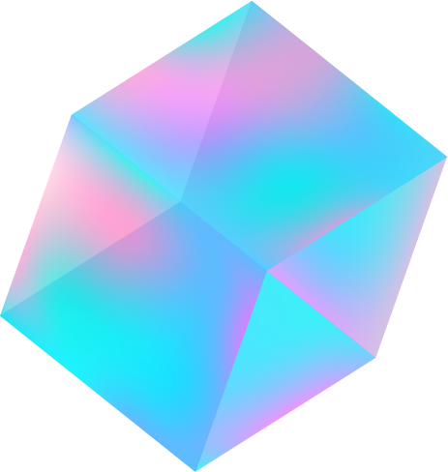
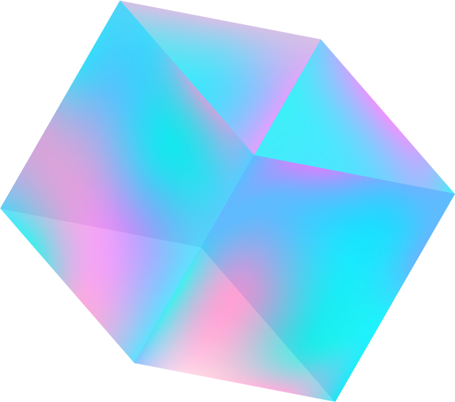

Points & Sprites
In Three.js
By Team Jolly Ranger

Slide 2
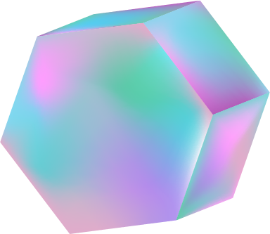

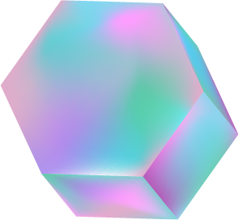
Members
01
02
03
04
Shafina Chaerunisa
5025201129
Denta Bramasta Hidayat
5025201116
Selomita Zhafiirah
5025201120
Muhammad Fatih Akbar
5025201117

Slide 3
Table of contents
01
02
03
04
Points &
Sprites
Differences
Live Example
References

Slide 4
01
Points &
Sprites

Slide 5

THREE.Points
Formerly known as PointsCloud, is a class for displaying points. The points are rendered by the WebGLRenderer using gl.POINTS.
Points are typically used for geometry or renders that requires a lot of Particles.
Constructor:
Points( geometry : BufferGeometry, material : Material )

Slide 6
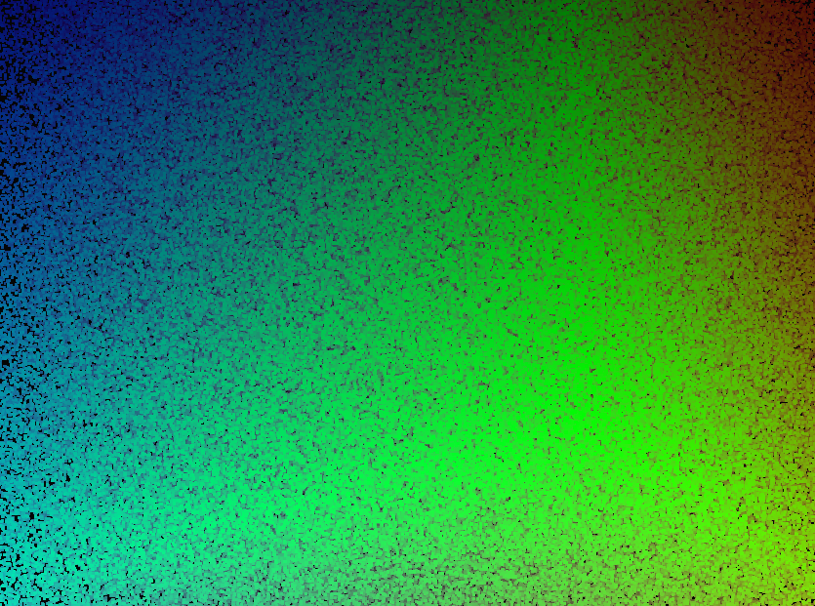
PointsMaterial
Formerly known as PointsCloudMaterial, it is the default material used by THREE.Points
Constructor:
PointsMaterial( parameters : Object )
As it is a part of the Material class, its parameters can have the same properties like most of the other materials in Three.js

Slide 7
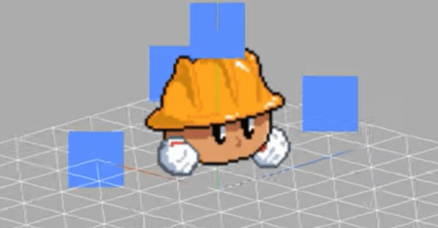
THREE.Sprites
A sprite is a plane that always faces towards the camera, generally with a partially transparent texture applied. Since a sprite itself is part of Object3D it can be utilized similarly to other Object3D class.
Sprites are generally used when little to single ‘particle’ is needed with greater control over it.
Constructor:
Points( geometry : BufferGeometry, material : Material )

Slide 8
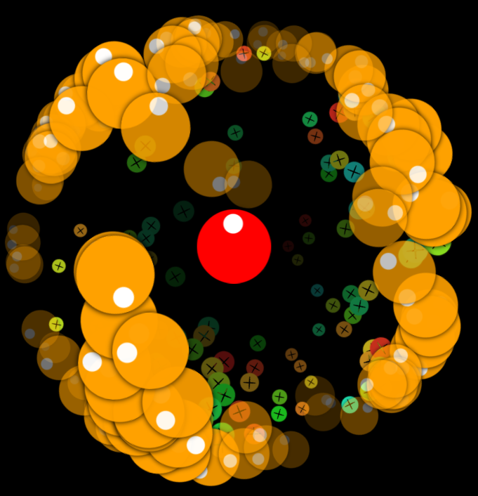
SpriteMaterial
SpriteMaterial is the default material for THREE.Sprite.
Constructor:
SpriteMaterial( parameters : Object )
Similarly to PointsMaterial As it is a part of the Material class, its parameters can have the same properties like most of the other materials in Three.js, with an exception of ClippingPlanes.

Slide 9
02
Differences

Slide 10
Points
Sprites
More suited at creating complex geometry/patterns and large amount of particle.
More suited at creating ‘particles’ at a smaller scale that need more individual control.
Each points belongs to a geometry that it has been assigned as.
Every sprites are their own separate objects.
Points are just vertices rendered as squares which are not automatically sorted by depth in render order
Sprites are based on Planes.

Slide 11
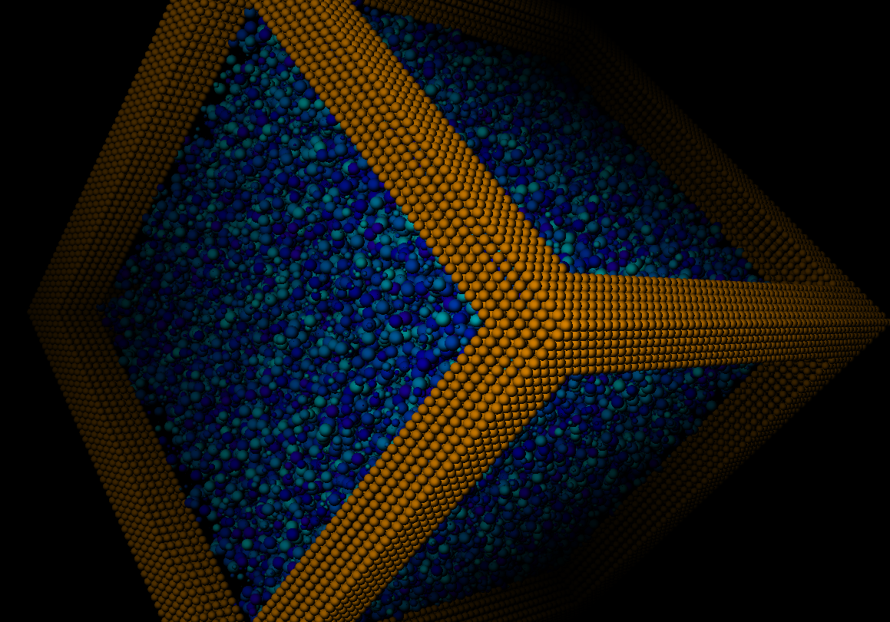
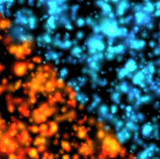
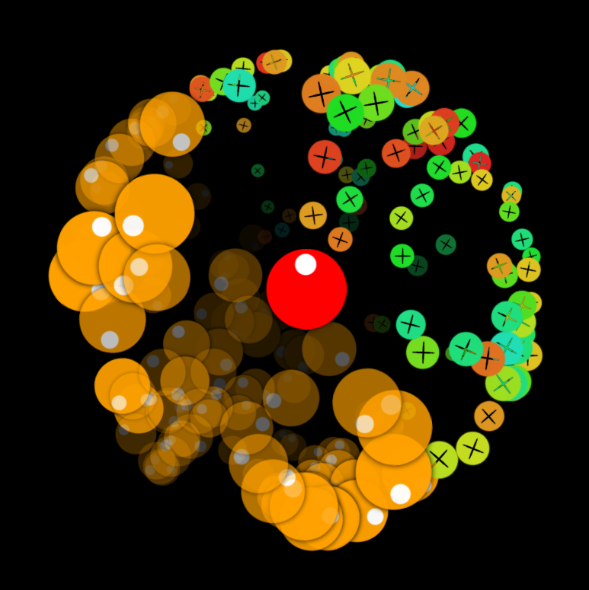
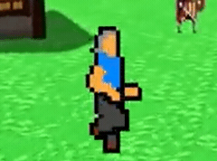
Use Cases
Points
Sprites

Slide 12
03
Live Example

Slide 13
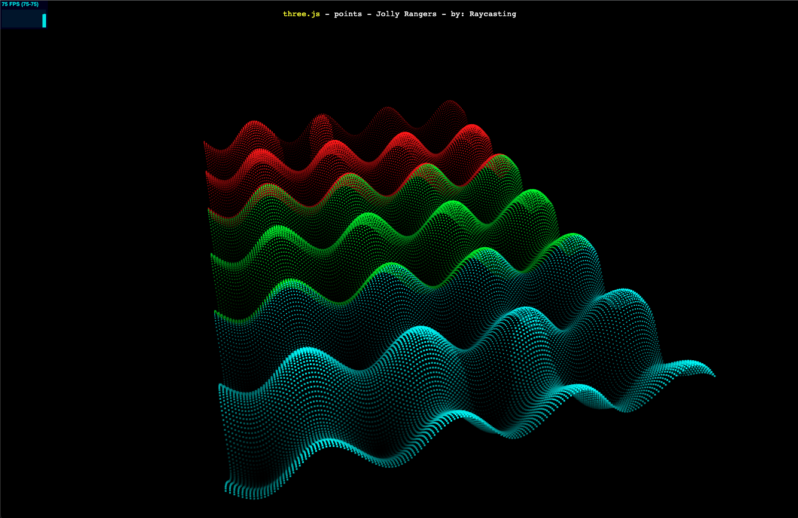
Points

Slide 14
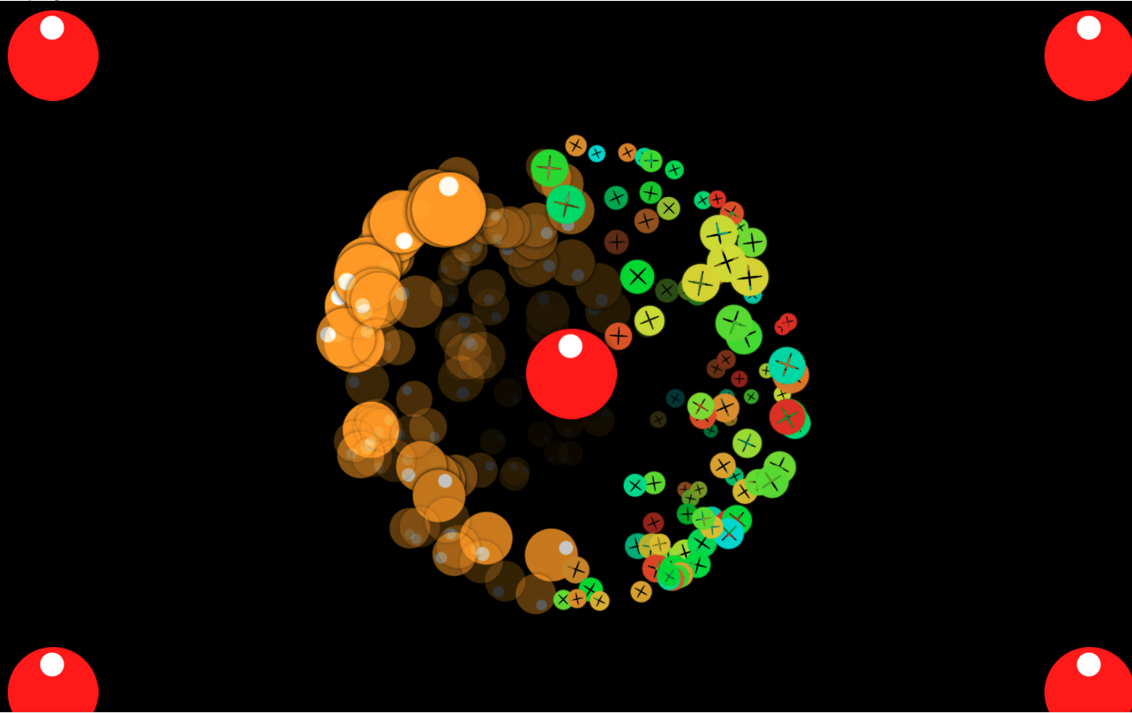
Sprites

Slide 15
04
References

Slide 16
References
https://threejs.org/docs/#api/en/objects/Points
https://threejs.org/docs/#api/en/objects/Sprite
https://threejs.org/docs/#api/en/materials/SpriteMaterial
https://threejs.org/docs/#api/en/materials/PointsMaterial
https://sites.google.com/site/threejstuts/home/particles
https://discourse.threejs.org/t/what-is-the-difference-between-sprite-and-points/41703
https://www.youtube.com/watch?v=pGO1Hm-JB90&ab_channel=Genka

Slide 17
Thanks!
Do you have any questions?

